Slide 1
Tabulating and Graphing Data?
Business Intelligence Systems and Data Mining
IMAT5168 Analytics Programming

Slide 2

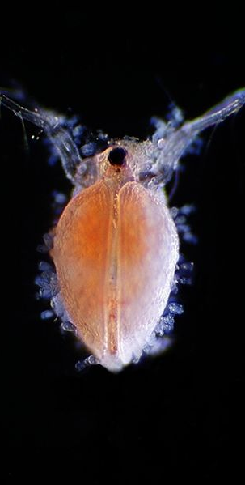
Assessing Toxicity of Pollutants in Aquatic Systems
We will be using research data reported here:
Bailer A, Oris T. 1994. “Assessing Toxicity of Pollutants in Aquatic Systems”
Chapter 2 in Case Studies in Biometry, Lange N, Ryan L, et al eds. New Jersey: John Wiley & Sons Inc.
The data and SAS programs can be downloaded from – but see next slide:
http://www.stats.ox.ac.uk/pub/datasets/csb/
Picture: Ceriodaphnia
http://commons.wikimedia.org/wiki/File:Ceriodaphnia.jpg

Slide 3
Nitrofen Data Set
nitrofen.dat & nitrofen.sas can be downloaded from Blackboard.
Data set:
Animal animal id (Ceriodaphnia dubia)
Conc concentration of nitrofen
Brood 1-3 no. of offspring in 3 successive broods
Total total number of offspring

Slide 4
Simple tabular reports with put
/* Example from Bailer Chapter 2 – Display 2.14 */
data _null_; /* Don’t create a SAS data set */
set nitrofen;
by conc; /* NB data already sorted using proc sort */
file 'nitrofen.txt';
/* Output a header, each time concentration changes */
if FIRST.CONC then do;
put 50*'-';
put "Animal" @10 "Conc" @20 "Total" @30 "First?" @40 "Last?";
end;
/* Output the data */
put animal @10 conc @20 total @30 FIRST.CONC @40 LAST.CONC;
run;

Slide 5
Export data in CSV form using put
/* Use the put statement */
data _NULL_; /* write variable names to file */
file 'nitrofen.csv' dsd;
put "conc,animal,brood1,brood2,brood3,total";
run;
data _NULL_;
set nitrofen; /* add data below variable names */
file 'nitrofen.csv' dsd MOD;
put conc animal brood1 brood2 brood3 total;
run;
/* Use the ODS and proc print */
ods csv file="nitrofen.csv";
proc print /* use proc print to output a csv */
data=nitrofen;
var conc total;
id animal; /* use id instead of observation # */
run;
ods csv close; /* Don’t forget this! */

Slide 6
Import/export…
proc import /* Read data from a CSV file */
out = nitrofen
datafile = "nitrofen.csv"
dbms = csv
replace
;
getnames=yes; /* First line has variable names */
datarow=2; /* So the data start in line 2 */
guessingrows=32768; /* Use 32768 rows to find data types & lengths */
run;
proc export /* Write data from a CSV file */
data = nitrofen
outfile = "nitrofen.csv"
dbms = csv
replace
;
putnames=yes; /* Output the variable names */
run;

Slide 7
Tabulation
proc tabulate allows you to control:
Table layout
Data format
Labels
Summary statistics
proc tabulate provides more precise control over the content of tables than proc means or proc univariate.
NB: proc report is an alternative which combines print, means and tabulate to produce summary reports.

Slide 8
Building a table…
Variable | Sample Size | Min | Q1 | Median | Q3 | Max
Brood1
Brood2
Brood3
Total
Start with a sketch…

Slide 9
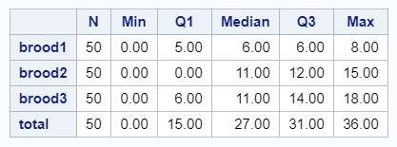
The basic design
proc tabulate data = NITROFEN;
var /* set analysis variables */
brood1 brood2 brood3 total;
table /* describe table to print */
brood1 brood2 brood3 total /* rows */
, n min q1 median q3 max; /* columns */
run;

Slide 10
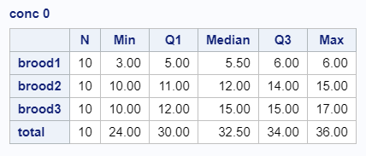
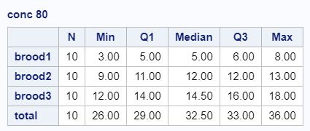
Stratify by concentration
proc tabulate
data = nitrofen;
class conc; /* set classifier variable */
var brood1 brood2 brood3 total; /* set analysis variables */
table
conc /* pages (1 for each value) */
, brood1 brood2 brood3 total /* rows */
, n min q1 median q3 max; /* cols */
run;

Slide 11
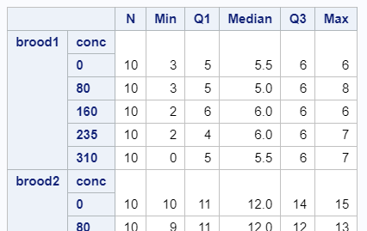
Brood then concentration…
proc tabulate data = nitrofen;
class conc;
var brood1 brood2 brood3 total;
table
(brood1 brood2 brood3 total) * conc /* rows */
, n min q1 median*f=4.1 q3 max; /* cols */
run;

Slide 12
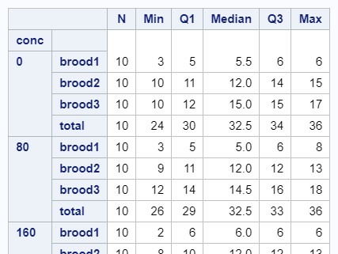
Concentration then brood…
proc tabulate data = nitrofen;
class conc;
var brood1 brood2 brood3 total;
table
conc * (brood1 brood2 brood3 total) /* rows */
, n min q1 median*f=4.1 q3 max; /* cols */
run;

Slide 13
Using summary data
Suppose we wish to classify data using averages, medians or other summary data
Steps
Summarize the data and output the summary to a data set
Merge the summary data with each record of the original data set
Classify each record in the new data set
Tabulate the results

Slide 14
Summarize the data and output
proc univariate
data = grades;
var examm; /* average of exam1 & exam2 */
id student; /* for extreme observations */
output
out = gstats /* data set */
median = median /* statistic */
;
run;

Slide 15
Merge and classify
/* See: http://www2.sas.com/proceedings/sugi23/Begtutor/p50.pdf */
data grades;
/* Merge summary stats with each row of grades data */
if _n_ = 1 then
set gstats; /* read stats */
set grades; /* merge with every grades */
/* Classify students using calculated statistic */
if exam1 <= median then
prediction = 'poor’;
else
prediction = 'good’;
run;
/* Carry out your analysis of choice ... */

Slide 16
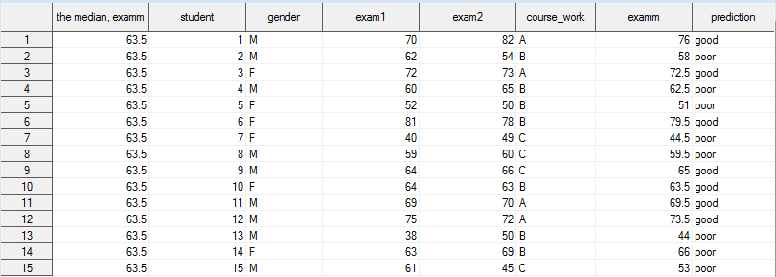
Merged dataset
Column 1: the median from gstats
Columns 2-7: the data from grades
Column 8: the new classifier variable

Slide 17
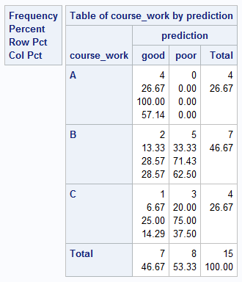
Does grade predict exam1 mark?
Exploratory analysis
Results
/* grade versus prediction (exam1) */
proc freq
data = grades;
tables
course_work /* rows */
* prediction /* cols */
;
run;

Slide 18
The Output Delivery System
Output delivery system (ODS)
Outputs SAS data to the destination of choice…
PDF – portable document format
RTF – rich text format (for e.g. Microsoft Word)
HTML – html for web pages
Usage:
ods pdf file = 'grades.pdf';
proc print
data = grades;
run;
ods pdf close; /* don’t forget this! */

Slide 19
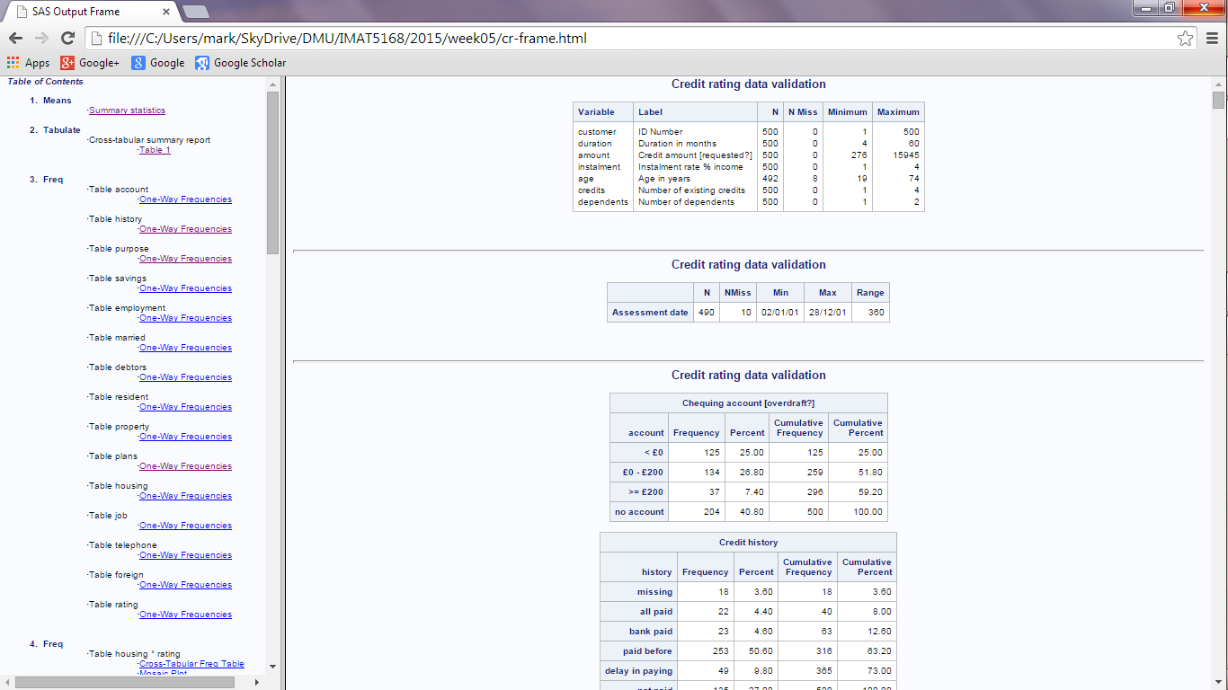
HTML Tricks - Create a web site using the ODS

Slide 20
HTML How to…
Let SAS take the strain …
To see the site, navigate to: file:///C:/YOUR_PATH_HERE/loan-risk/cr-frame.html
ods html
path='C:\YOUR_PATH_HERE\loan-risk'
body = 'cr-body.html' /* Output of analyses */
contents = 'cr-TOC.html' /* Table of contents */
frame = 'cr-frame.html' /* Organizes display */
newfile = NONE; /* All results to 1 file*/
/* the code (e.g. from your analysis of the credit-rating data) */
ods html close;

Slide 21
If you don’t want all the output…
/*
In SAS 9.4, tick:
Tools->Options->Preferences->Results->Listing
to see the results in the output window
*/
/* In SAS University edition, the output appears in the log. */
ods trace on
/ listing; /* List output components */
proc univariate /* Example procedure */
data = grades;
var examm; /* median exam mark */
run;
ods trace off;

Slide 22
If you don’t want all the output…
proc univariate outputs:
To find these names, look in trace listing under: “Output added”
Moments
BasicMeasures
TestsForLocation
Quantiles
ExtremeObs
/* show only extreme observations */
ods select ExtremeObs;
proc univariate
data = grades;
var examm;
id student;
run;
ods select all; /* show all output */

Slide 23
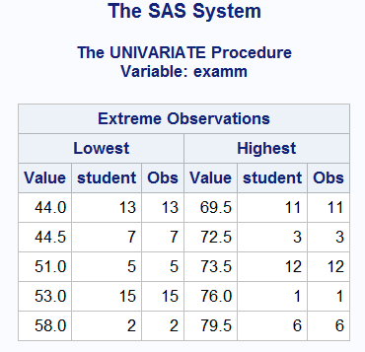
If you don’t want all the output… - Example: show extreme observations

Slide 24
Exploratory data analysis
Business Intelligence Systems and Data Mining IMAT5168 Analytics Programming

Slide 25
Statistical Reasoning
Research question
Population
Usually impractical to enumerate completely
Sample of subjects
Obtained from the population using a sampling method
Measure the subjects
Continuous data (e.g. numbers)
Do the data fit a distribution?
i.e. are the data appropriately summarized using a measure of central tendency (mean) and variability (standard deviation).
Categorical data
Have the categories been consistently applied?

Slide 26
Statistical Reasoning
Formulate a model of relationships between variables
What is the dependent variable?
What are the independent variables?
Are there variables that are related to both, which may need to be “controlled for”?
Build a statistical model
Using knowledge of the properties of random variables
Infer
Draw conclusions about the population by looking for evidence against a claim about it
Interpret
the discovery of an association
taking account of the methods of:
Sampling (to whom does the result apply)
Measurement, including the effects of missing data (how valid is the result)

Slide 27
Statistical Graphs
Exploratory data analysis
1977 Tukey
Approach to analysing data sets
Focuses on visual methods
Summarises the main characteristics of data
Example
Tip rate = 0.18 – 0.01 * bill size
See: http://en.wikipedia.org/wiki/Exploratory_data_analysis

Slide 28
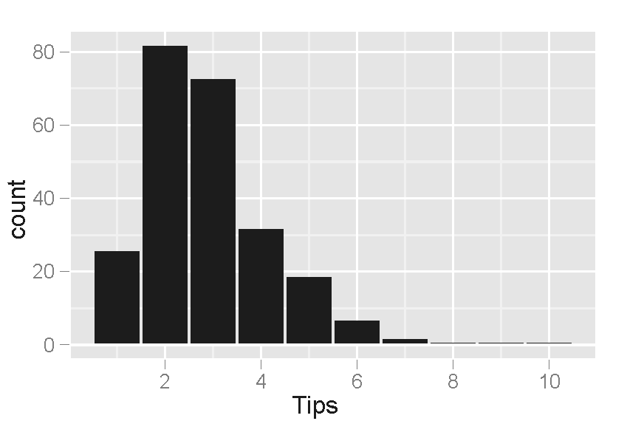
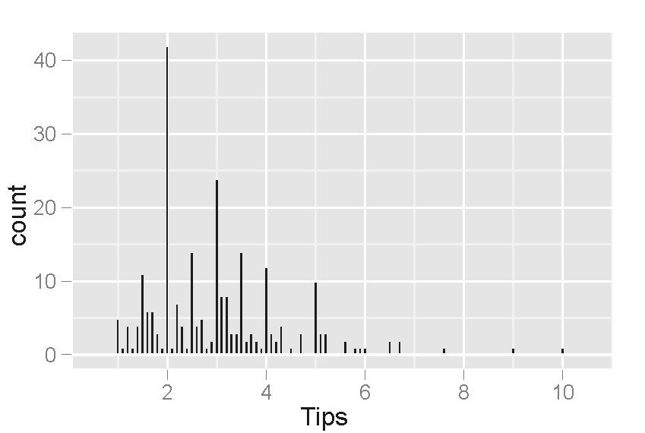
Increase the number of bins to see detailed structure
peaks occur at the whole-dollar and half-dollar amounts, which is caused by customers picking round numbers as tips
Increasing the number of bins shows…

Slide 29
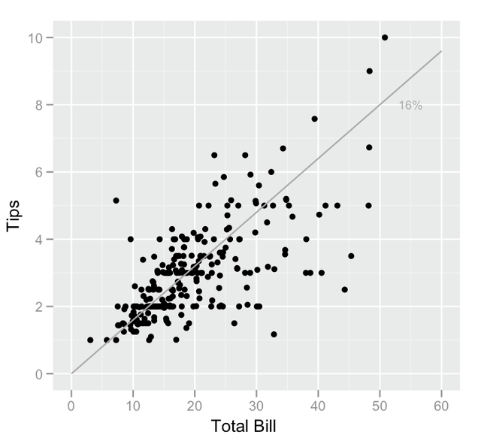
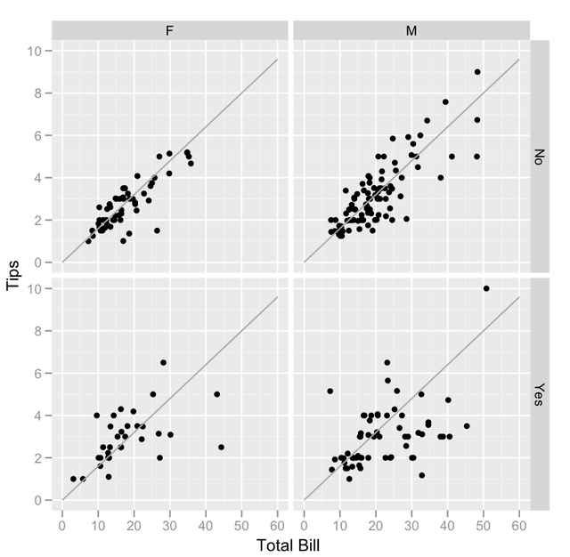
Re-draw scatter plots by explanatory variables
Smoking parties have a lot more variability in the tips that they give. Males tend to pay the (few) higher bills, and the female non-smokers tend to be very consistent tippers
Points below the line correspond to tips that are lower than expected (for that bill amount), and points above the line are higher than expected.

Slide 30
(Trivial) things to remember
Data
Prefer to describe the source of data
When obtained
Sampling method
Measurement method
Scales
Prefer to include zero
Prefer to state measurement units
Categorical data
Prefer to define how categories were determined
Prefer to use a legend to explain plots

Slide 31
Case Study: Nitrofen Data
Suppose you were given the Nitrofen data to analyse:
How could exploratory data analysis be used?
Summarize
dependent variable (brood count)
independent variable (nitrofen concentration)
Tabulate
brood count vs nitrofen concentration
Examine scatter plots
Total offspring in brood by concentration
Offspring in brood by concentration
Carry out statistical analysis
Which statistical model is appropriate?

Slide 32
Summarize the outcome variable
Standard histogram…
Alternative with more format options…
proc univariate
data = nitrofen;
var total;
histogram /
normal;
run;
proc sgplot
data = nitrofen;
histogram total /
nbins=36;
xaxis values = (0 to 40 by 2);
density total;
keylegend /
location=outside
position=top;
run;

Slide 33
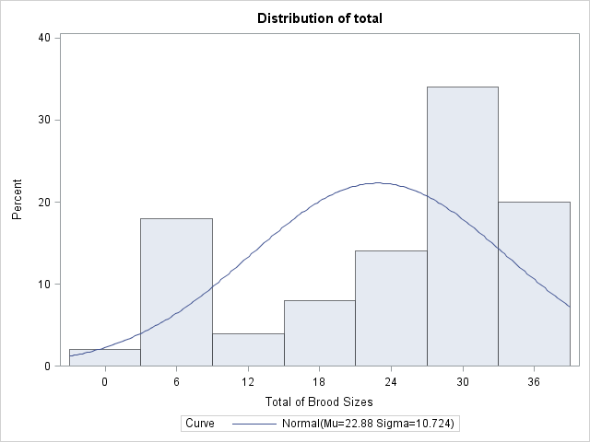
proc univariate

Slide 34
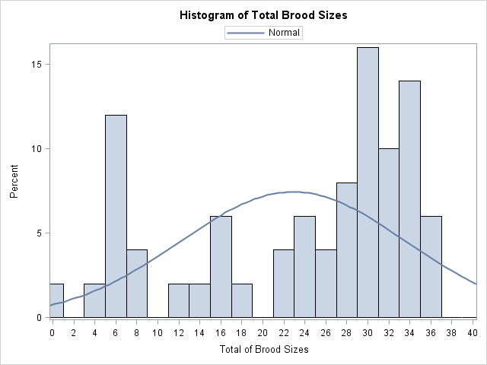
proc sgplot

Slide 35
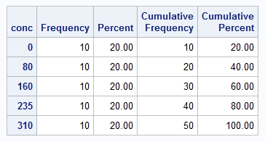
Summarize independent variable
The code…
The result
proc freq
data = nitrofen;
table conc;
run;

Slide 36
Conclusions so far…
The independent variable has 10 observations for each level of concentration, in accordance with the experimental design.
The dependant variable is not normally distributed and cannot easily be transformed to a normal distribution
It has no tail to positive values (right skewed)
It has no tail to negative values (left skewed)
The data are bi - or tri – modal (# of peaks).

Slide 37
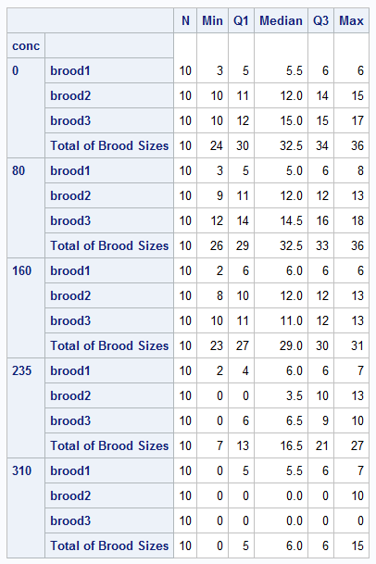
Examine expected relationships
The code
The results…
proc tabulate
data=nitrofen
format = 3.;
class conc;
var
brood1
brood2
brood3
total;
table
conc*(brood1 brood2 brood3 total)
, n min q1 median*f=4.1 q3 max;
run;

Slide 38
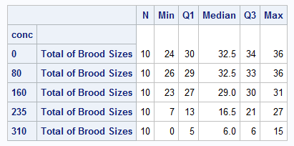

Conclusion so far…
As the concentration increases so the total brood size decreases but in a non-linear manner.
Possible regression model: $\sqrt{total}=m×conc+c$
Leaves out the brood number (1st, 2nd or 3rd)

Slide 39
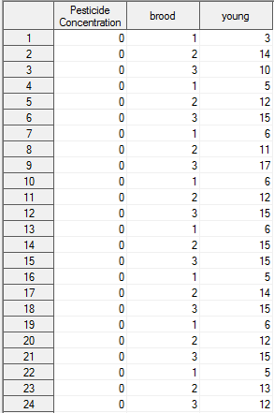
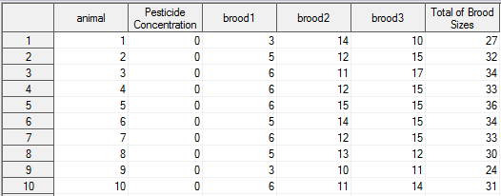
Create a variable to identify the brood…
Before preparation…
After preparation…

Slide 40
Examine expected relationships
Data preparation
Panel of graphs
data nitrofen_r;
set nitrofen;
brood = 1;
young = brood1;
output;
brood = 2;
young = brood2;
output;
brood = 3;
young = brood3;
output;
keep conc brood young;
run;
proc sgpanel
data = nitrofen_r;
panelby brood;
loess x=conc y=young;
run;
/*
NB LOESS:
= regression
applied to small sub-sets of data
*/

Slide 41
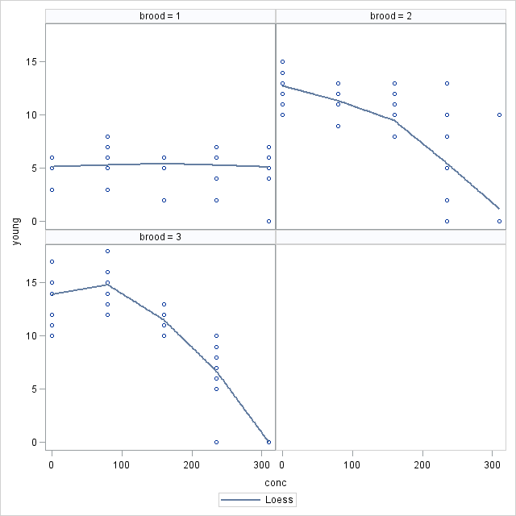
Pesticide vs Brood count

Slide 42
Conclusions so far…
The first brood is unaffected by increasing concentrations of pesticide.
The second and third broods are increasingly severely affected by pesticide.
There may be an interaction between the brood number and the concentration of pesticide.
As brood number increases, the effect of pesticide increases.

Slide 43
Annotated graphs
See ‘nitrofen-annotated.sas’ program
The program does not work with SAS University Edition because it uses proc gplot.
Uses ‘annotation’
Creation of a dataset with instructions for drawing on graphs
Useful for adding lines, arrows, circles and text to annotate a figure
See Bailer, p250 (optional)
The purpose is to illustrate what can be done.

Slide 44
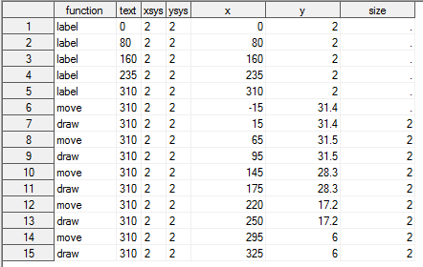
Example annotation data set

Slide 45
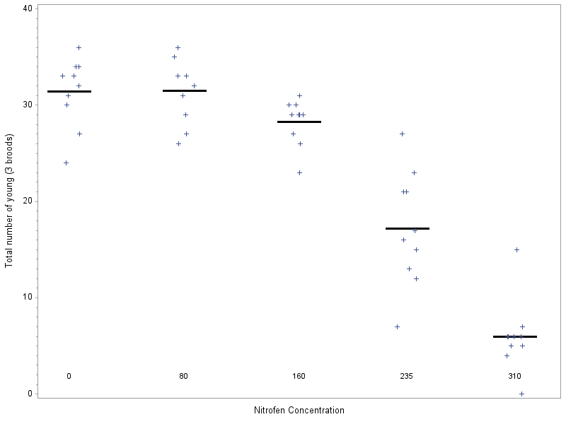
Distribution of responses vs concentration

Slide 46
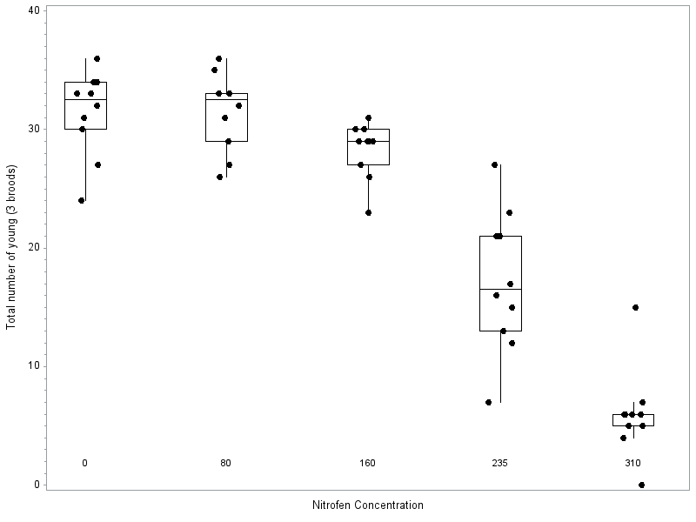
Distribution of responses vs concentration with box-plot

Slide 47
Other ‘advanced’ topics
Things to read about…
ODS Graphics Editor
Allows you to edit graphical output
See Bailer, p206
Graphical templates
Allows you to modify the appearance of ‘standard’ graphs produced by statistical packages
proc template
SAS/GRAPH Graph Template Language
proc sgrender

